Slide 1

Advanced Data Compression Techniques: Project Review
Smart Compression Framework for IoT Sensor Healthcare Data using Adaptive Modelling

Slide 2
Team Members
RAVISHANKAR G (22MIC0034)
THAUN R (22MIC0061)
ANIRUDHAN R (22MIC0067)
MOHAMED ISRAAR (22MID0101)

Slide 3

Abstract: Smart Compression for IoT Healthcare Data
The exponential growth of Internet of Things (IoT) applications in healthcare generates vast volumes of sensor data. This project introduces a Smart Compression Framework for IoT Sensor Data, intelligently reducing data size while preserving critical information.
We utilized the Human Vital Sign Dataset
from Kaggle and compared lossless
compression techniques:
LZW (Existing Methodology)
Zstandard (zstd) (Proposed Methodology)
Performance was evaluated using Compression Ratio (CR), Space Saving (SS), and Processing Time to identify the optimal solution for real-time monitoring and remote patient care.

Slide 4
Key Objectives: Enhancing IoT Data Efficiency
Develop a Smart Framework
Compare Lossless Techniques
Assess Performance Metrics
Create a compression framework for IoT healthcare sensor data that intelligently reduces size while preserving critical medical information.
Implement and evaluate LZW/xz (existing) and Zstandard (proposed) compression algorithms for efficiency.
Quantitatively measure Compression Ratio (CR), Space Saving (SS), processing time, and data retention accuracy.
Optimize Storage & Transmission
Enhance Scalability & Adaptability
Enable faster data transfer and reduced bandwidth usage for real-time IoT applications.
Provide a robust framework suitable for continuous sensor data streams without compromising accuracy.

Slide 5

Existing Methodology: LZW Compression
The existing methodology leverages Lempel–Ziv–Welch (LZW) compression. LZW is a classic lossless algorithm known for its dictionary-based encoding, historically used in formats like GIF and TIFF.
Baseline Model: Serves as the benchmark against which newer algorithms like Zstandard are compared.
Implementation: Custom Python scripts (LZW_Logic.ipynb and LZW_Dataset_Compression.ipynb) preprocess, tokenize, and compress the Human Vital Sign Dataset.
Design Goal: Achieve maximum compression ratio with zero information loss, ensuring bitwise identical data upon decompression.
This method prioritizes data integrity and high compression density over speed, a common trade-off in traditional compression.

Slide 6

Limitations of Existing Methodology
Processing Overhead
Lack of Adaptability
Dictionary-based algorithms like LZW can consume significant memory, especially with large or continuously streaming datasets, impacting performance on resource-constrained IoT devices.
LZW does not dynamically adjust compression parameters based on data variability, a crucial requirement for heterogeneous and unpredictable IoT sensor data.
Slow Decompression for Large Datasets
No Support for Incremental Compression
While XZ offers high compression, its decompression speed can be slow, making it unsuitable for real-time IoT applications requiring immediate data access.
The batch processing nature of this approach means it requires the full dataset before compression, which is impractical for continuous, live sensor data streams.

Slide 7

Proposed Methodology: Zstandard Compression
The proposed Smart Compression Framework incorporates the Zstandard (zstd) algorithm, developed by Facebook. Zstandard is designed for high-speed, lossless data compression, making it highly suitable for IoT sensor data.
Real-time Adaptability: Tunable compression levels and fast decompression speeds cater to dynamic IoT environments.
Performance Enhancement: Aims to surpass LZW in compression and decompression throughput while maintaining data integrity.
Implementation: Utilizes the zstandard library in Python with the Human Vital Sign Dataset.
Zstandard provides an optimal balance between compression ratio, speed, and resource utilization, which are essential for continuous sensor networks and edge computing.

Slide 8






Advantages of Proposed Methodology (Zstandard)
High-Speed Decompression
Adaptable Compression Level
Enables near real-time data reconstruction for live health monitoring.
Allows dynamic tuning between speed and compression ratio.
Low Latency
Lightweight Implementation
Reduces transmission time between IoT devices and cloud endpoints.
Optimized zstd library for embedded devices and edge processors.
Cloud Compatibility
Error-Free Recovery
Seamless integration with cloud platforms for storage and analytics.
Maintains complete data fidelity, ideal for medical-grade IoT data.

Slide 9
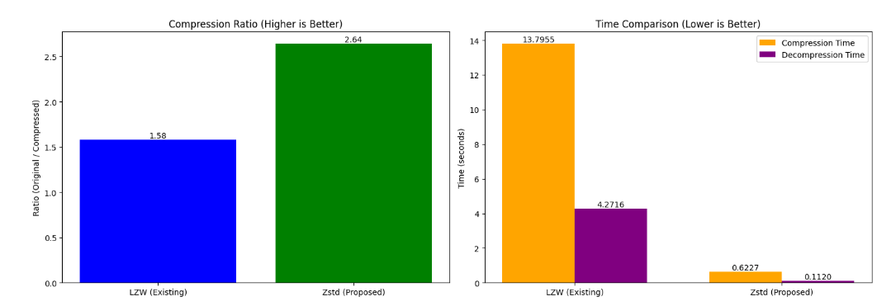
Conclusion: Balancing Efficiency and Performance
We successfully developed a Smart Compression Framework for IoT sensor data, using the Human Vital Sign Dataset to minimize storage and transmission costs while preserving data integrity.
LZW/xz (Existing): Achieved compression (~1.58) and 32% space saving, but suffered from slower processing and limited adaptability.
Zstandard (zstd, Proposed): Achieved high compression (~2.65) but demonstrated significantly faster processing, higher adaptability, and better suitability for real-time IoT streams.
Key Takeaway: Zstandard effectively balances compression efficiency and computational performance, making it ideal for scalable, low-latency IoT healthcare monitoring.
Future enhancements include hybrid adaptive models, edge-based compression optimization, and secure/encrypted compression for sensitive IoT data.

Slide 10





Real-World Applications
Smart Healthcare
Wearable Devices
Continuous patient monitoring with low bandwidth requirements.
Reduces data redundancy and energy consumption for extended battery life.
Smart Cities / Homes
Emergency Response Systems
Efficiently compresses large streams of environmental sensor data.
Fast, real-time, low-latency transmission of critical vital signs.

